Slide 1

Department of Computer Science and Engineering
VIGNAN’S LARA INSTITUTE OF TECHNOLOGY AND SCIENCE
Project Review
On
Data-Driven Methods for Early Detection of Neurodegenerative Disorder
PRESENTED BY:
K.EMMANUEL WATSON
I.NAVEEN KUMAR
K.SAI VINAY
K.ARUN KUMAR
Under The Esteemed Guidance of
Mr. Ch. Yadhavendra Kumar M.Tech , Ph.D
Assistant Professor
Department of CSE
(22FE1A0578)
(22FE1A0565)
(22FE1A0575)
(22FE1A0593)
23/01/2026 Department of Computer Science and Engineering

Slide 2
TITLE
Data-Driven Methods for Early Detection of Neurodegenerative Disorders
23/01/2026 Department of Computer Science and Engineering

Slide 3
CONTENTS
Project Title
Problem statement
Introduction
Motivation & Background
Objectives
Scope & Limitations
Literature Survey & Existing System
Gap Analysis
Proposed System
23/01/2026 Department of Computer Science and Engineering

Slide 4
CONTENTS
System Architechture
Module Description
Technology Stack
Algorithms Used
Data Set Details
Work Progress
Sample Outputs
Testing and Validation
Project Plan and Time Line
Remaning Work
Team Roles
Conclusion
References
23/01/2026 Department of Computer Science and Engineering

Slide 5
ABSTRACT
Alzheimer’s disease (AD) is a leading form of dementia and is rapidly increasing worldwide. It causes brain cell death, leading to symptoms such as memory loss, difficulty with calculations, and confusion about recent events. Early detection of AD is highly beneficial for patients and their families. Electroencephalography (EEG) has emerged as a reliable biomarker for AD diagnosis.
In this work, EEG signals are preprocessed through filtering and artifact removal using Independent Component Analysis (ICA), followed by feature extraction with wavelet transform. These features are then classified using a Support Vector Machine (SVM) to distinguish AD patients from healthy individuals.
23/01/2026 Department of Computer Science and Engineering

Slide 6
MOTIVATION
Alzheimer’s disease (AD) is ranked as the sixth leading cause of death in the United States and is considered a chronic neurodegenerative disorder caused by the death of brain cells. It is most prevalent among people aged sixty-five and above, and its prevalence is expected to increase significantly in the coming years. The disease is progressive and classified into three stages: mild, moderate, and severe. The mild stage, also known as Mild Cognitive Impairment (MCI), is marked by short-term memory loss, difficulty in calculations, and forgetting names or recent events. In the moderate stage, patients experience severe memory loss, an inability to handle simple tasks, language difficulties, and confusion about time and place. The severe stage leaves the patient completely dependent, with loss of speech, difficulty walking, and an inability to recognize even close family members.
23/01/2026 Department of Computer Science and Engineering

Slide 7
  BACKGROUND
Currently, there is no permanent treatment for Alzheimer’s disease. However, early detection can help patients and families prepare for the future. Several diagnostic methods exist, such as Mini-Mental State Examination (MMSE), Clinical Dementia Rating (CDR), Positron Emission Tomography (PET), Single Photon Emission Computed Tomography (SPECT), Magnetic Resonance Imaging (MRI), and EEG. Among these, PET and SPECT involve radiation risks, while MRI is costly, making EEG a safer and more effective choice for diagnosis. Despite its effectiveness, EEG signals often contain noise and artifacts such as eye blinks and power interference, which must be removed before reliable diagnosis can be performed.
23/01/2026 Department of Computer Science and Engineering

Slide 8
  OBJECTIVES
Early stage detection of Neurological Disorders which can help to identify in primary effects and also take care proper diagnoses .
Expected to achieve maximum accuracy in detecting AD from the Electroencephalography(EEG) scan or graphs.
Develop user Interactive Pages (UI) to make the ease of accessibility with the assistance of deep learning models and graphs to depict the
output .
23/01/2026 Department of Computer Science and Engineering

Slide 9
  SCOPE & LIMITATIONS
Scope:
Training of deep learning models with ds004504 dataset obtained from open Neuro consisting of 88 subjects , each having 25 features corresponding diseases to reach effective predictions.
Limitations:
Inadequate data set , the above dataset obtained is the minimal in size.
Ineffective processing and depends on linear models which makes the output
Inaccurate and ambigious to handle or understand.
23/01/2026 Department of Computer Science and Engineering

Slide 10

LITERATURE SURVEY
S.No | Paper Title | Methodology | Drawbacks | Proposed Methodology to overcome those drawbacks
1. | Detection of Alzheimer’s Disease with Shape Analysis of MRI Images | The process involves image segmentation, extraction of brain regions with reslicing, and contour detection, followed by feature extraction through P-type Fourier descriptors. | MRI is costly procedure and it could also lead to radiation risks | Using PET(Positron Emission tomography),SPECT(Single Photon Emission Computed Tomography),MMSE(Mini-Mental State Examination)
24/12/2022
Department of Computer Science & Engineering
10

Slide 11
LITERATURE SURVEY
S.No | Paper Title | Methodology | Drawbacks | Proposed Methodology to overcome those drawbacks
2. | Early Prediction of Alzheimer’s Disease Dementia Using Baseline MRI and Longitudinal Cognitive Measures with Deep RNNs. | An LSTM autoencoder learns temporal features from cognitive tests, combined with baseline hippocampal MRI in a Cox regression model to predict MCI progression to AD. | Missing data issues, reliance on threshold-based classification, limited generalization of assumptions, and absence of longitudinal imaging. | Use LSTM autoencoder with MRI and cognitive data to capture temporal dynamics, handle irregular data, and improve prediction accuracy and timing.
24/12/2022
Department of Computer Science & Engineering
11

Slide 12
LITERATURE SURVEY
S.No | Paper Title | Methodology | Drawbacks | Proposed Methodology to overcome those drawbacks
3. | An unsupervised ROI extraction model (GANCMLAE4TAU) for tau PET images to improve Alzheimer’s diagnosis by detecting individual tau depositions. | The GAN-based autoencoder uses two encoders, one decoder, and a discriminator to extract ROIs from 3D tau PET scans, validated with SSIM, PSNR, MSE, and ROC. | Missing data issues, reliance on threshold-based classification, limited generalization of assumptions, and absence of longitudinal imaging. | Use LSTM autoencoder with MRI and cognitive data to capture temporal dynamics, handle irregular data, and improve prediction accuracy and timing.
24/12/2022
Department of Computer Science & Engineering
12

Slide 13
LITERATURE SURVEY
S.No | Paper Title | Methodology | Drawbacks | Proposed Methodology to overcome those drawbacks
4. | A preliminary study on the impact of EEG density on TMS-EEG classification in Alzheimer’s disease using machine learning classifiers. | TMS-evoked EEG responses from 17 AD and 17 HC were processed, features extracted, and classified using Decision Tree, kNN, and Random Forest, with high-density electrodes giving best accuracy. | Small dataset size and reliance on manual preprocessing limit generalization; lower performance with medium and low-density electrode sets. | Use larger datasets with automated preprocessing, explore frequency and connectivity features, and validate across multiple centers to improve robustness.
24/12/2022
Department of Computer Science & Engineering
13

Slide 14
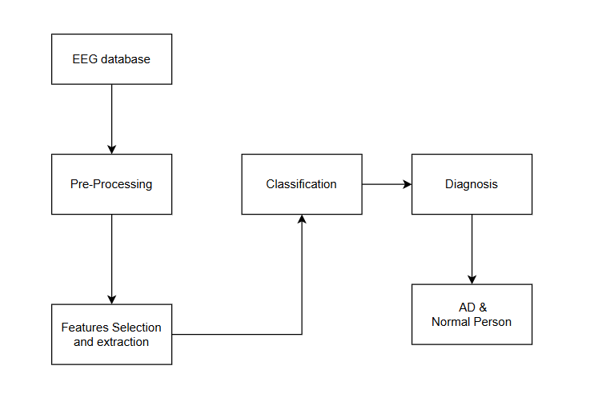
EXISTING SYSTEM
Performance comparison of SVM and NMD
System | Accuracy(%)
SVM | 90
NMD | 35
23/01/2026 Department of Computer Science and Engineering

Slide 15
Existing System
The existing methods for diagnosing Alzheimer’s disease primarily involve clinical examinations such as MMSE and CDR, medical imaging like MRI, and advanced scans such as PET and SPECT.
While these methods can provide useful results, they come with significant limitations.
PET and SPECT impose radiation risks, while MRI, though accurate, is expensive and not always accessible.
MMSE and CDR are widely used but have limited accuracy in detecting patients at early stages of the disease.
Research has shown that EEG analysis can provide important insights into brain function in Alzheimer’s patients.
Patterns such as the slowing of EEG signals, reduced complexity, and changes in synchrony have been observed in patients compared to healthy individuals.
23/01/2026 Department of Computer Science and Engineering

Slide 16
GAP ANALYSIS
Drawbacks of existing Methodogies:
MRI is costly procedure and it could also lead to radiation risks
Missing data issues, reliance on threshold-based classification, limited generalization of assumptions, and absence of longitudinal imaging.
Small dataset size and reliance on manual preprocessing limit generalization; lower performance with medium and low-density electrode sets.
23/01/2026 Department of Computer Science and Engineering

Slide 17
PROPOSED SYSTEM
The proposed system aims to address the shortcomings of existing methods by introducing a dual approach consisting of detection.
In this proposed system , we make use of below mentioned algorithms in order to achieve higher & effective detection of Alzheimer’s disease in early stages.
Detection is carried out using EEG signals, which are processed to remove artifacts, and then analyzed through feature extraction and classification techniques.
ALGORITHMS USED :
Classical ML: XGBoost, Random Forests.
Hybrid: Wavelet Scattering + XGBoost/Random Forest.
Deep Learning: EEGNet (CNN), Temporal Convolutional Network (TCN).
Meta-Learning: Stacking Ensemble combining best-performing models.
23/01/2026 Department of Computer Science and Engineering

Slide 18
PROPOSED SYSTEM
XGBoost
    An efficient gradient boosting algorithm optimized for speed and performance.
        Handles large-scale data well and reduces overfitting using regularization.
Random Forests
An ensemble of decision trees where predictions are averaged (classification/voting).
Robust against noise and prevents overfitting by using bagging and feature randomness.
Riemannian Geometry + Logistic Regression
Uses covariance matrices of EEG signals in Riemannian space for feature representation.
Wavelet Scattering + XGBoost/Random Forest
Wavelet scattering extracts stable, time-frequency features from EEG signals.
These features are fed into ML models (XGBoost/Random Forest) for classification.
EEGNet (CNN)
A compact Convolutional Neural Network (CNN) designed specifically for EEG data.
Learns spatial, temporal, and spectral patterns directly from raw EEG signals.
23/01/2026 Department of Computer Science and Engineering

Slide 19
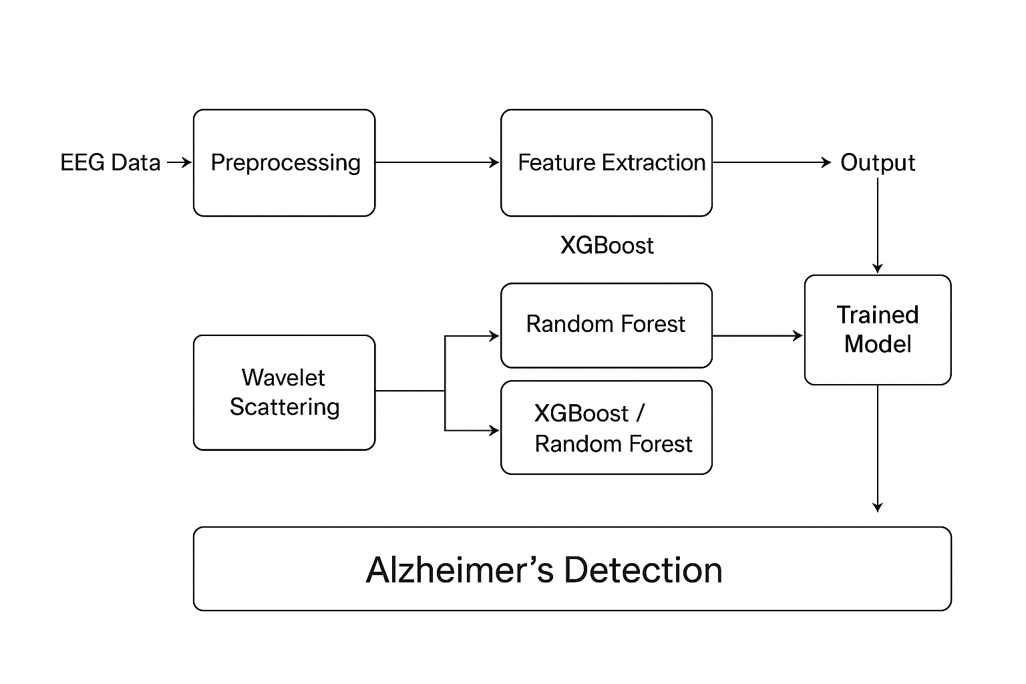
SYSTEM ARCHITECTURE
23/01/2026 Department of Computer Science and Engineering

Slide 20
MODULE DESCRIPTION
1.Data Collection
EEG signals are collected from participants, including both healthy controls and individuals at risk of Alzheimer’s.
Metadata such as age, gender, and clinical diagnosis are also recorded.
2.Preprocessing of EEG Signals
Noise removal (e.g., filtering, artifact removal from eye blinks and muscle movement).
Signal normalization and segmentation into epochs for uniform analysis.
Conversion into suitable feature spaces (time, frequency, and time-frequency domains).
3.Feature Extraction
Wavelet Scattering to capture time–frequency information from EEG signals.
Riemannian Geometry for covariance-based features preserving brain connectivity patterns.
Statistical features (mean, variance, entropy) derived from EEG segments.
23/01/2026 Department of Computer Science and Engineering

Slide 21
MODULE DESCRIPTION
4.Model Training
Multiple algorithms are applied and compared for classification:
XGBoost and Random Forests for tree-based classification.
Riemannian Geometry + Logistic Regression for robust covariance-based learning.
EEGNet (CNN) to automatically learn spatial–temporal patterns.
Temporal Convolutional Networks (TCN) for modeling sequential dependencies.
Stacking Ensemble combines outputs of base models for improved accuracy.
5.Model Evaluation
Train–test split or cross-validation applied to ensure generalization.
Metrics: Accuracy, Precision, Recall, F1-Score, and AUC are used for performance evaluation.
Comparison between traditional ML (XGBoost, Random Forest, Logistic Regression) and deep learning approaches (EEGNet, TCN).
23/01/2026 Department of Computer Science and Engineering

Slide 22
MODULE DESCRIPTION
Output & Deployment
Best-performing model stored as a trained model.
Predictions exported (e.g., to CSV or dashboard) for interpretation.
Final system designed as a pipeline where EEG data → preprocessing → model inference Alzheimer’s detection.
23/01/2026 Department of Computer Science and Engineering

Slide 23
TECHNOLOGY STACK
Programming Languages Used:
Using Python to develop deep Neural Networks for data preprocessing and
Web Application development for real time use with StreamLit frameworks
Libraries Used:
StreamLit for the Web Application Development.
Scipy , scikit Learn , Numpy , MatplotLib for graphical representation of the data
Algorithms Used:
Wavelet Scattering ,XGBoost , RandomForest , Riemannian Geometry and Logistic Regression
TCN(Temporal CNN) , EEGNet , Stacking Ensemble Learninig.
23/01/2026 Department of Computer Science and Engineering

Slide 24
TECHNOLOGY STACK
HARDWARE REQUIREMENTS:
A laptop or PC with NVIDIA GPU (8GB+ for basics ,16GB)
Multi-Core CPU (8 cores/ octacore)
Fast SSD storage with running with any os with python,tensorflow
SOFTWARE REQUIREMENTS:
OS : windows 10+
Core libraries:numpy,pandas,scikit-learn,pytorch/tensorflow
GPU accelration:NVIDIA CUDA toolkit
Environment: anaconda,miniconda.
23/01/2026 Department of Computer Science and Engineering

Slide 25
DATA SET DETAILS
The dataset ds004504 is obtained from OpenNeuro.org using AWS Command Line Interface,
The dataset ds004504 contains EEG graphs of 88 individual subjects , each comprising of
25 features that helps in detection of AD ,FTD , MCI disorders.
These 88 subjects are seperately used to classify and extract various features that assist in understanding and extracting features.
The size of the data is found to be 6GB with various features consisting of epochs 18407
Wavelet Scattering ,XGBoost , RandomForest , Riemannian Geometry and Logistic Regression
TCN(Temporal CNN) , EEGNet , Stacking Ensemble Learninig.
23/01/2026 Department of Computer Science and Engineering

Slide 26
TEAM ROLES
Member 1(22FE1A0565):
Model Development,Creation of predictive model for accessing features and data training without any loss of data and error minimization
Member 2 (22FE1A0575):
Training And Testing of Model,the model training and testing was done on the basis of model development and accuracy modes obtained helping in maximum effective data access and predictivity
Member 3(22FE1A0593):
Feature Extraction,extraction of features available in the dataset that helps in training of data,leading to data filtering and preprocessing.
23/01/2026 Department of Computer Science and Engineering

Slide 27
TEAM ROLES
Member 4((22FE1A0578):
UI Development and integration,development of user interfaces using StreamLit,making the program easier to access for the user to provide input and understand Output
23/01/2026 Department of Computer Science and Engineering

Slide 28
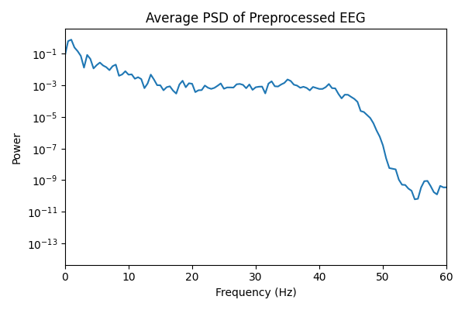
SAMPLE OUTPUTS
The following image tells about the time - series graph.representing the brain activity.according to which the prediction of Mild Cognitive Impairment(MCI).and its stages as Early,moderate and final stage.the feature extraction of the frequencies as per time required.
23/01/2026 Department of Computer Science and Engineering

Slide 29
SAMPLE OUTPUTS
The following image tells about the time - series graph.representing the brain activity.according to which the prediction of Mild Cognitive Impairment(MCI).and its stages as Early,moderate and final stage.the feature extraction of the frequencies as per time required.
23/01/2026 Department of Computer Science and Engineering

Slide 30
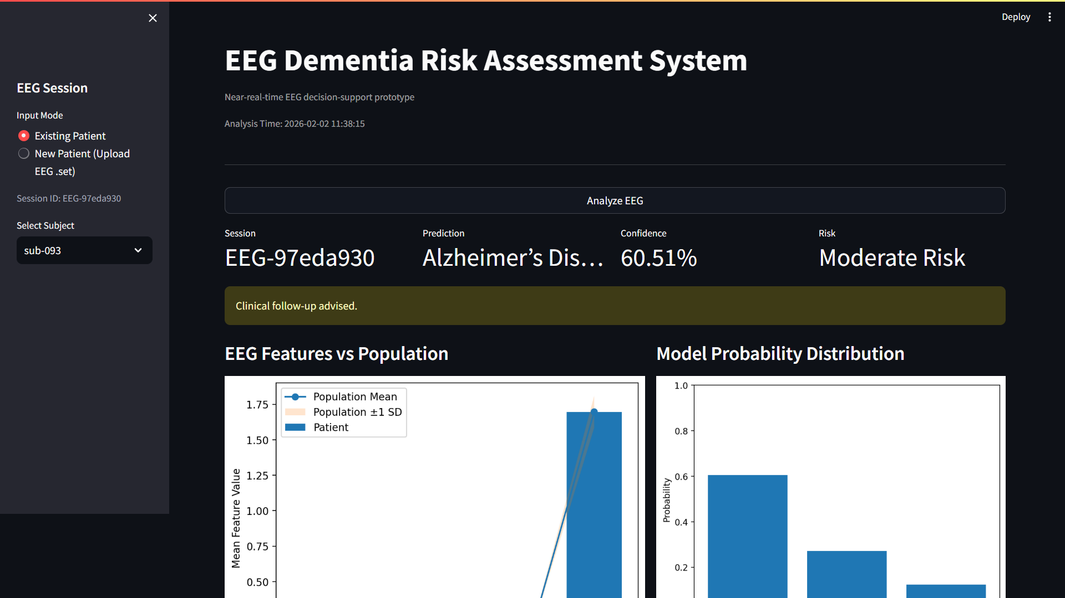
SAMPLE OUTPUTS
The following image gives the information about the participants as selected , gives out the confidence value for perspective stage of Frontotemporal Dementia(FTD).we can even generate a Clinical Report on basis estimate.
23/01/2026 Department of Computer Science and Engineering

Slide 31
CONCLUSION
Currently, there is no permanent treatment for Alzheimer’s disease. However, early detection can help patients and families prepare for the future. Several diagnostic methods exist, such as Mini-Mental State Examination (MMSE), Clinical Dementia Rating (CDR), Positron Emission Tomography (PET), Single Photon Emission Computed Tomography (SPECT), Magnetic Resonance Imaging (MRI), and EEG. Among these, PET and SPECT involve radiation risks, while MRI is costly, making EEG a safer and more effective choice for diagnosis.
This Predictive model will help the users to identify AD in its Primary Stages,making the users to take care of their family member,which could help them either to recover or be Better along with their present Condition of MCI i.e Alzhemier`s Diseases.
23/01/2026 Department of Computer Science and Engineering

Slide 32
REFERENCES
“Alzheimer Disease Detection and Tracking of Alzheimer Patient “Priyanka Thakare Department of Electronics & Telecommunication Bharati Vidyapeeth's College of Engineering for Women, for Better and Safer Living (BRC), pp 1-6, 26-28 May 2014.
Ahmad Akl, Babak Taati, and Alex Mihailidis, “Autonomous Unobtrusive Detection of Mild Cognitive Impairment in Older Adults”, IEEE Transactions On Biomedical Engineering, pp 1383- 1394, VOL. 62, NO. 5, MAY 2015.
Brian Roark, Margaret Mitchell, John-Paul Hosom, Kristy Hollingshead, and Jeffrey Kaye, “Spoken Language Derived Measures for Detecting Mild Cognitive Impairment”, IEEE Transactions On Audio, Speech, And Language Processing, pp 2081- 2090,Vol. 19, NO. 7, September 2011.
Chenhui Hu†, Pan Zhou∗ , Member, IEEE and Quanzheng Li “Early Diagnosis of Alzheimer’s Disease Based on Resting-State Brain Networks and Deep Learning” Ronghui Ju†, Student Member, IEEE,
23/01/2026 Department of Computer Science and Engineering

Slide 33
THANK YOU

